Slide 1
Requirements Presentation
Digital Copycat
Nicholas Byers (EE)
Emily Feller (CE)
Peter Garate (EE)
Benjamin Martinez (CE)
Ayana Rodgers (DASE)
Jacqueline Wrobel (EE)
Dr. Adham Atyabi (Sponsor)
Professor William Michael (Faculty Advisor)
4 December 2020

Slide 2
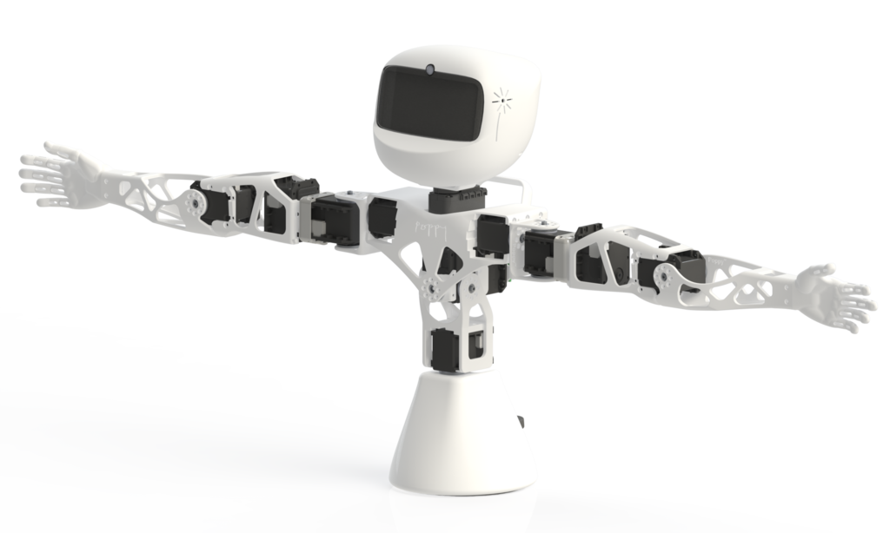
Problem Overview
Customer requires a robot that can mimic movements of a human
Robot shall be constructed to resemble basic human torso features
Robot shall be constructed from 3D printed material, computer hardware, and software
Robot shall optically track position and movements of a particular human subject and replicate their motion with high accuracy
Robot shall use machine learning to interpret and predict proper joint and limb movements
Robot shall perform the tasks above as close to real time as possible
Notes:
Problem Overview 1, maybe 2 slides
Use the fewest words possible
A bullet outline
Suitable graphics
Explain your problem in a broad overview
Nick

Slide 3
Interactive learning method for teaching children with Autism. Utilize functions to assist in areas of socialization, communication, and playful behavior through robot-based intervention.
Evaluation Implementation of Humanoid Robot for Autistic Children: A Review
Humanoid Robot NAO Interaction with Autistic Children of Moderately Impaired Intelligence to Augment Communication Skills
Shamsuddin, Syamimi, et al. “Humanoid Robot NAO Interacting with Autistic Children of Moderately Impaired Intelligence to Augment Communication Skills.” Procedia Engineering, vol. 41, 2012, pp. 1533–1538.
Yousif, Jabar, et al. “Evaluation Implementation Of Humanoid Robot For Autistic Children: A Review.” International Journal of Computation and Applied Sciences, vol. 6, Feb. 2019, pp. 412–120.
Notes:
Note any difficult areas you are not working on —Out of Scope
Shamsuddin, Syamimi, et al. “Humanoid Robot NAO Interacting with Autistic Children of Moderately Impaired Intelligence to Augment Communication Skills.” Procedia Engineering, vol. 41, 2012, pp. 1533–1538.
Yousif, Jabar, et al. “Evaluation Implementation Of Humanoid Robot For Autistic Children: A Review.” International Journal of Computation and Applied Sciences, vol. 6, Feb. 2019, pp. 412–120.

Slide 4
In compliance with IEC 860601-1 specific to medical robots for basic safety and essential performance:
The essential performance shall pose no unacceptable risk to a patient if motion control of the device has performance degradation.
When in motion and within reach of people the robot shall not present an unacceptance risk
Risk control applicable to mechanical hazards include a risk control measure
Torso designed to support the robot in all its movements
https://collateral-library-production.s3.amazonaws.com/uploads/asset_file/attachment/17911/BNG-UL19-Robotics-WP-112219.pdf

Slide 5
In compliance with ISO/TC 261 – specific to international standardization committee on additive manufacturing:
Material extrusion-based additive manufacturing of plastic materials
General principles — Standard practice for part positioning, coordinates and orientation
Qualification principles — Classification of part properties for additive manufacturing of polymer parts
Environment, health and safety — Consideration for the reduction of hazardous substances emitted during the operation of 3D printer in workplaces

Slide 6
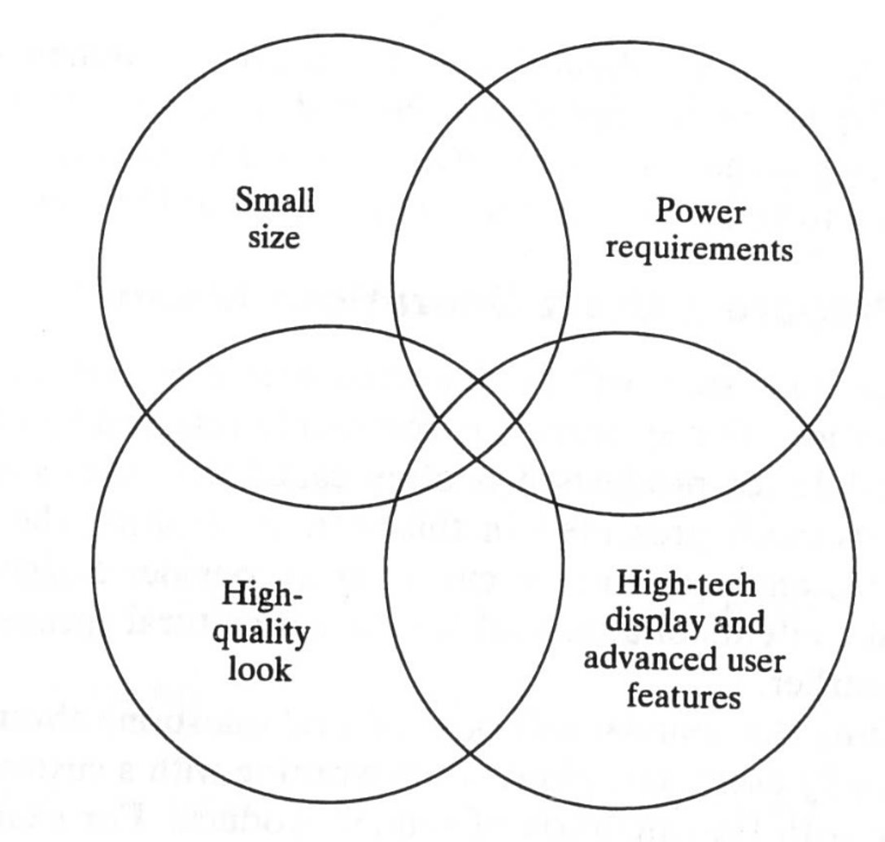
Constraints
Movement
Not capable of physically moving locations
Arm, shoulder, waist, neck
Environment
Indoor environment only
Table-top
Expertise
New to machine learning
New to poppy/motors/camera
Power Supply
Bound by plug-in to a power supply
Use a limited battery supply
Movement
Environment
Expertise
Power
Supply
Notes:
Ben

Slide 7
Requirements Analysis
Customer's Needs: A robot capable of imitating pre-recorded upper body movements from a demonstrator.
Customer's Wants: A Poppy Torso with an Opti-Tracker Camera that utilizes Machine Learning to track targets placed on the demonstrator.
Project Boundaries: The project's boundaries include the allotted time given to complete project goals through the phases of development while adhering to the project scope.
Real-World Considerations: Smooth movements and durability. Complexity Creep.

Slide 8
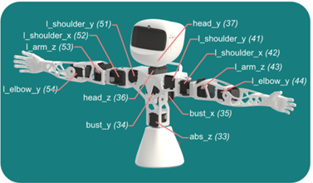
System Design Expectations
3D Printed exterior
Moving Joints
Shoulder
Arm
Wrist
Head
Torso
Raspberry Pi
Embedded board used for control
Optical Sensors
Correlate to Robot joints
Notes:
Emily

Slide 9
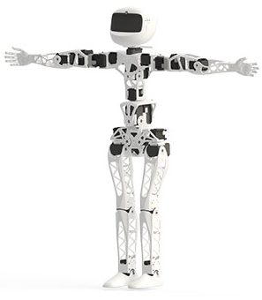
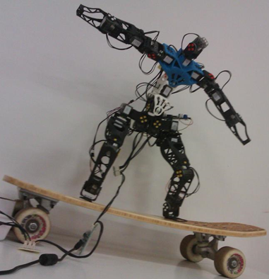
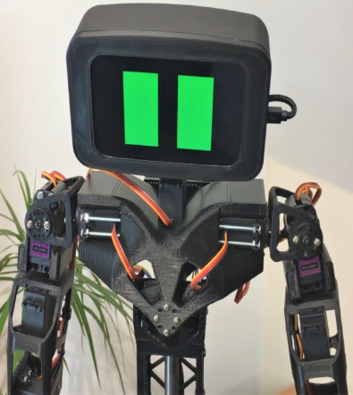
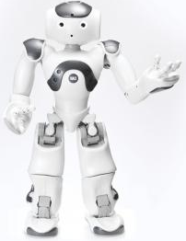
Open-Source Models
Poppy Project
Poppyrate
[5]
[6]
Aster
NAO
[7]
[8]

Slide 10
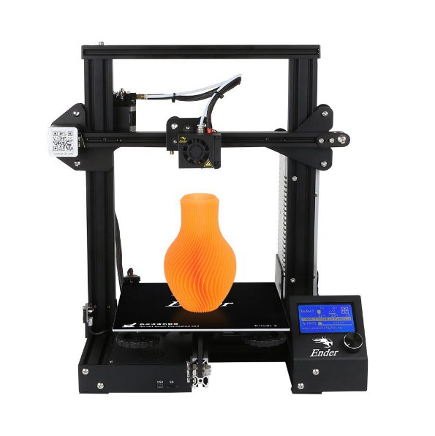
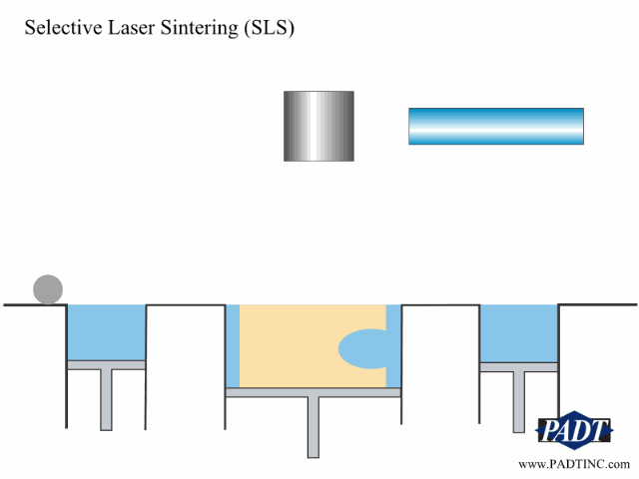
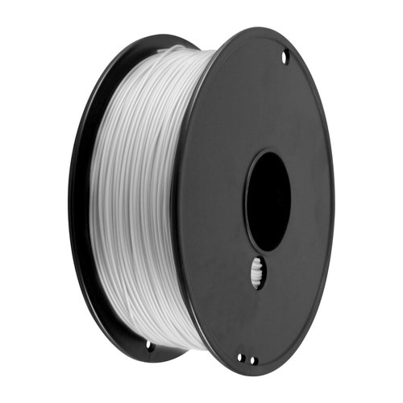
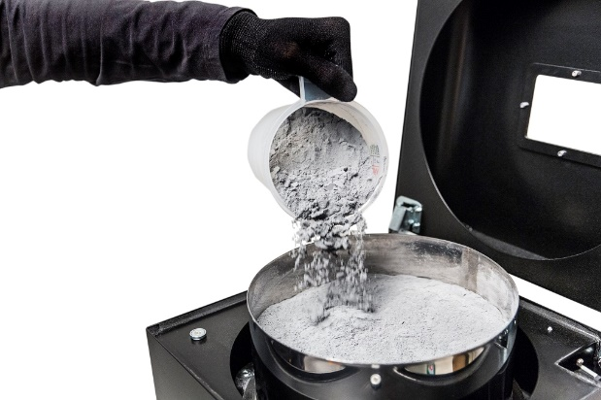
3D printing
Fused Deposition Modeling (FDM)
-vs-
Selective Laser Sintering (SLS)
Filament/Powder Material
PLA – Polylactic Acid
PETG – Polyethylene Terephthalate Glycol
Polyamide – Glass Filled Nylon
Method
Print with personal printer
Use Additive Manufacturing Lab on campus
Order through online business
[1]
[2]
[3]
[4]

Slide 11
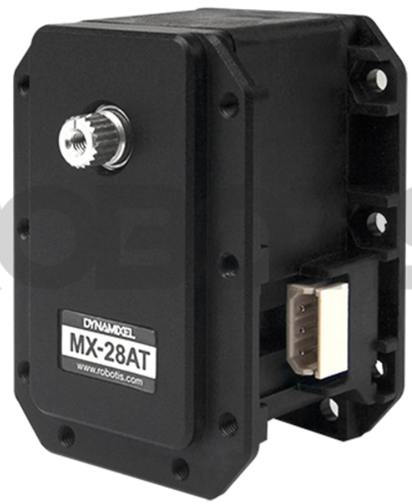
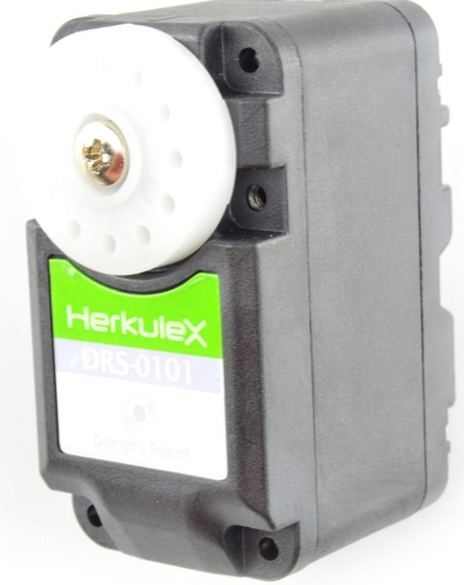
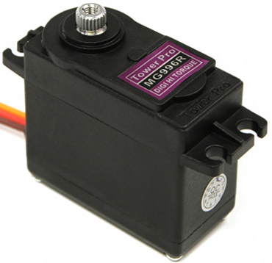
Servos
Dynamixel
HerkuleX
TowerPro
[9]
[10]
[11]

Slide 12
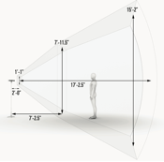
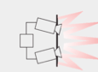
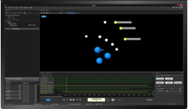
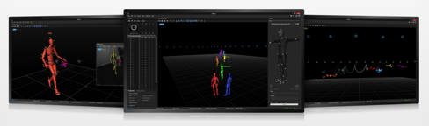
Optical Tracking Cameras
Markers used to track joint movement
Track absolute position over time
Software considerations
Camera SDK
Motive: Tracker
Data format considerations:
Mocap data
2D & 3D reconstruction
Markers & Labeling

Slide 13
Software Requirements To Focus On
Team Strengths in Coding
Versatile Capabilites
Universal Language
Smooth Continuation
Python
Jupyter Notebook

Slide 14
Software Requirements (cont.)
Must use Machine/Deep Learning
Be able to preprocess input data
Be able to train using learning models
Store learning data
Deploy that data

Slide 15
Requirements of Machine Learning
Successful and optimal use of machine learning requires certain hardware
GPU
Cost/performance, memory, cooling
RAM
Size, not speed
CPU
Supports GPUs
Impact of performance depends on preprocessing strategy
Hard Drive
Large and slow, possibly an SSD for productivity

Slide 16
Requirements of Machine Learning (Cont.)
Along with hardware capabilities, our use of ML will require some software components as well
Image processing
Machine Learning Libraries
TensorFlow
Pytorch
Pypot

Slide 17
Issues
Topic | Explanation
Machine Learning | Our team has little to no experience with machine/deep learning. As this is a large part of our project, there will be a learning curve.
Software Development Kit | The team is still searching for a suitable SDK. There is an option to create one as well.
Software Hardware Integration | The transfer of optical camera footage to correct software for the robot will be a long process that is new territory for the team.
Notes:
Emily

Slide 18
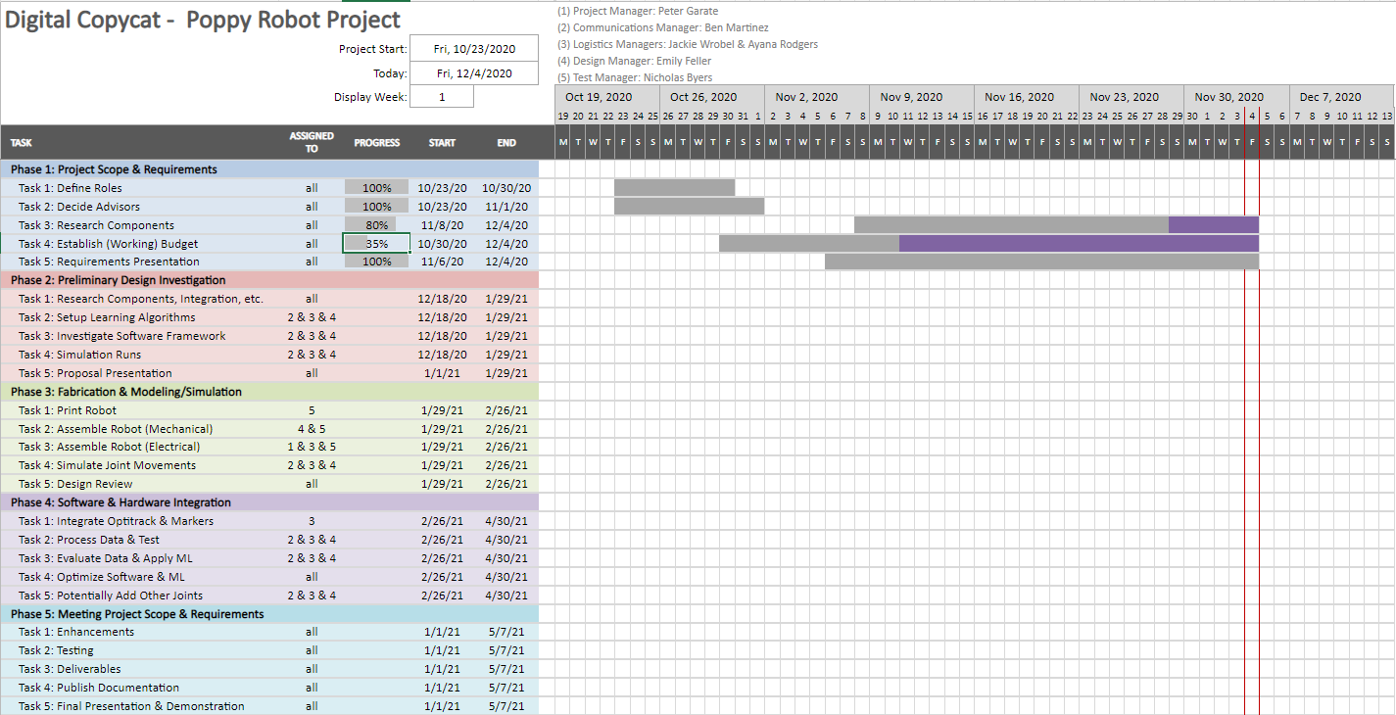
Timeline
Planning Tool – Gantt Chart
Notes:
Jackie
Show your planning tool
Sketch out how and when you plan to do things, show some division of labor, most importantly, show that you have a framework for doing the project
Include these important (approx. dates) milestones:
Project Proposal September 2
Design Review September 30
Final Presentation December 9

Slide 19
Draft Budget
Item | Quantity | Cost | Total
Raspberry Pi Board | 1 | 34.12 | 34.12
microSD card (32GB) | 1 | 18.00 | 18.00
OptiTrack Camera | 1 | ? | ?
Markers | 10 | 20.00 | 200.00
Ethernet Cable | 1 | 8.99 | 8.99
Dynamixel U2D2 (USB2AX) | 2 | 49.90 | 99.80
USB Hub | 1 | 9.99 | 9.99
Dynamixel MX-28AT (6pcs) | 3 | 1,529.50 | 4588.50
Dynamixel MX-28AT (servo) | 1 | 239.90 | 239.90
Dynamixel MX-64AT (servo) | 4 | 309.90 | 1239.60
Dynamixel AX-12A (act) | 2 | 44.90 | 89.80
HN07-N101 Horn & Bearing | 19 | 8.90 | 169.10
HN07-I101 Horn & Bearing | 12 | 14.10 | 169.20
HN05-I101 | 4 | 15.40 | 61.60
Cable (60 mm) | 1 | 10.90 | 10.90
Cable (100 mm) | 1 | 11.90 | 11.90
Cable (140 mm) | 1 | 12.90 | 12.90
Cable (200 mm) | 1 | 14.40 | 14.40
Filament (Glass Filled Nylon) Kg/2 | 1 | 59.99 | 59.99
Steel Nozzle | 1 | 9.99 | 9.99
Glue Sticks | 2 | 1.00 | 2.00
Total |  |  | 7050.68
Notes:
Jackie

Slide 20
Conclusion
Problem Overview
Problem Background
Standards
Constraints
Requirements Analysis Overview
Hardware Requirements
Software Requirements
Timeline
Budget
Notes:
Peter

Slide 21
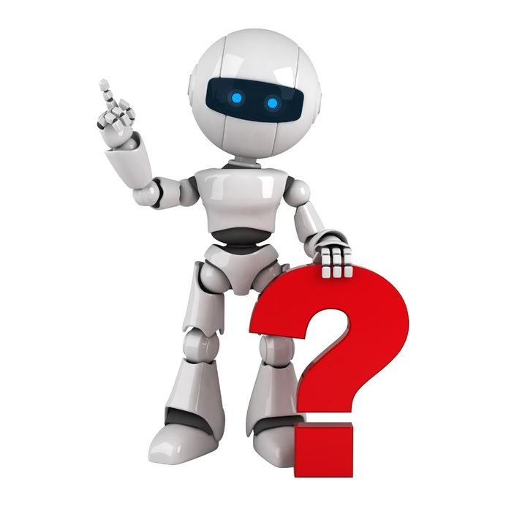

Slide 22
Work Cited
[1] https://creality3d.shop/products/creality-ender-3-3d-printer-economic-ender-diy-kits-with-resume-printing-function-v-slot-prusa-i3-220x220x250mm?gclid=Cj0KCQiAqo3-BRDoARIsAE5vnaJF415EyVNOBsP9v3sdu5xXf5CWQqtA_wiSVrmKVQMv7ETgrtNz-OIaAs5ZEALw_wcB
[2] https://www.padtinc.com/blog/rapid-prototyping-technology-animations/
[3] https://www.projectorscreenstore.com/3d-magic-pen-filament-roll-white-980-ft-roll.html
[4] https://3dprint.com/176233/sinterit-powder-sieve-lisa/
[5] https://www.poppy-project.org/en/
[6] https://www.zecloud.fr/poppyrate/
[7] https://www.thingiverse.com/thing:3992150
[8] https://www.softbankrobotics.com/emea/en/nao
[9] https://www.robotis.us/dynamixel-mx-28at/#gallery-1
[10] https://www.robotshop.com/en/herkulex-drs-0101-robot-servo.html
[11] https://hobbyking.com/en_us/towerpro-mg996r-10kg-servo-10kg-0-20sec-55g.html?utm_source=google&utm_medium=cpc&utm_campaign=google_us_shopping&countrycode=US&gclid=Cj0KCQiAqo3-BRDoARIsAE5vnaJfimxSPHq6c52fCzs0MVLV4TwX1GYWuzfw8CVrlmvR9uMxw8tHt0IaAqD3EALw_wcB&gclsrc=aw.ds
[12] https://medium.com/@alishbai734/inverse-kinematics-in-robotics-using-reinforcement-learning-2c252980b4cf
[13] https://www.simplilearn.com/keras-vs-tensorflow-vs-pytorch-article#:~:text=TensorFlow%20is%20an%20open%2Dsourced,because%20it's%20built%2Din%20Python.

